Slide 1

RoBust
Arab Academy for Science, Technology and Maritime Transport
5/1/2023
Nada Samir - 20100752
Nour Morsy - 20101066

Slide 2
Overview
Introduction
Benefits of Project
Components Description
Hardware Architecture and Cost
Stimulation and Schematic
Functional and Non Functional Requirements
System Functionality
Next Step
Resources

Slide 3
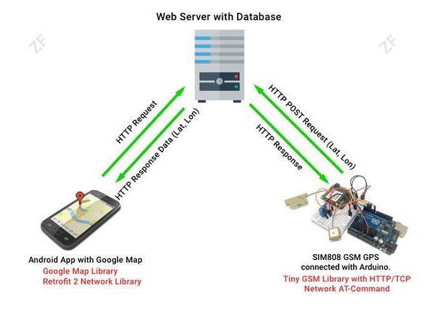
Introduction
There is a gap in AAST community for a bus tracker application for students and staff that needs to be filled.
The application should live-track the assigned bus using a tailored and engineered device.
The system should also allow the users to track and call the bus, receive notification about the bus (from driver or logistics commutes) and finally receive geo-alerts.

Slide 4
Benefits of Project
Being able to track academy buses departures and routes.
Organize and preserve students route privileges.
Organize bus routes.
Safety of the students and employees of the college and saving the college resources. .

Slide 5
Components Description and Cost
Components:
Arduino UNO ~ 240 EGP
Crystal LCD (16x2) ~ 300 EGP
Display Location
Push Button ~ 5 EGP
To initiate connection
SIM 808 ~ 1350 EGP
GPS/GSM Module: to get location and send it to server
Lithium Batteries ~ 300 EGP
Cost:
Approx 2200 EGP

Slide 6
Hardware Architecture
We used Arduino UNO connected with a GPS using a UART communication for extracting the location (longitude and latitude) of bus then send it by the SIM808-GSM using post request to server to save the location.
When the initiating button is pressed GPS system starts tracking the bus location.
It displays the location on a crystal LCD display 16x2.

Slide 7
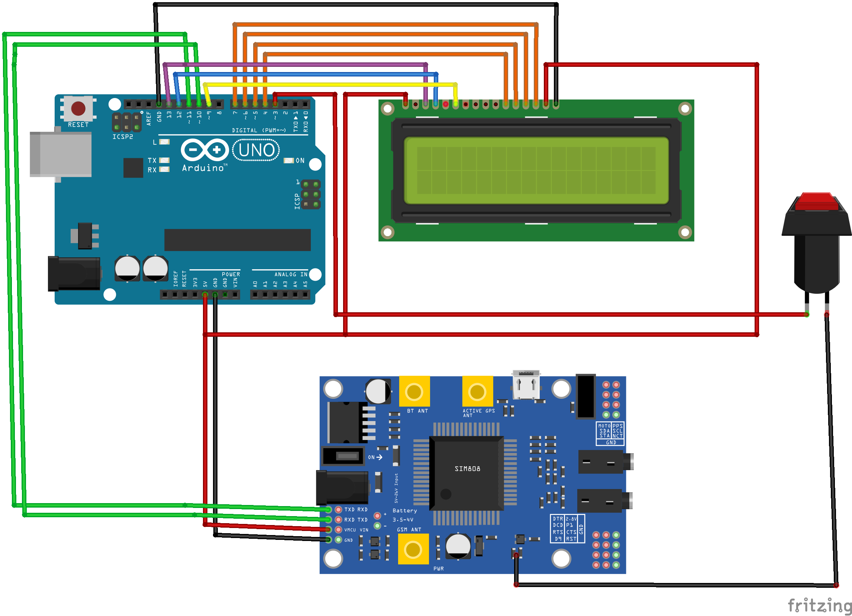
Stimulation

Slide 8
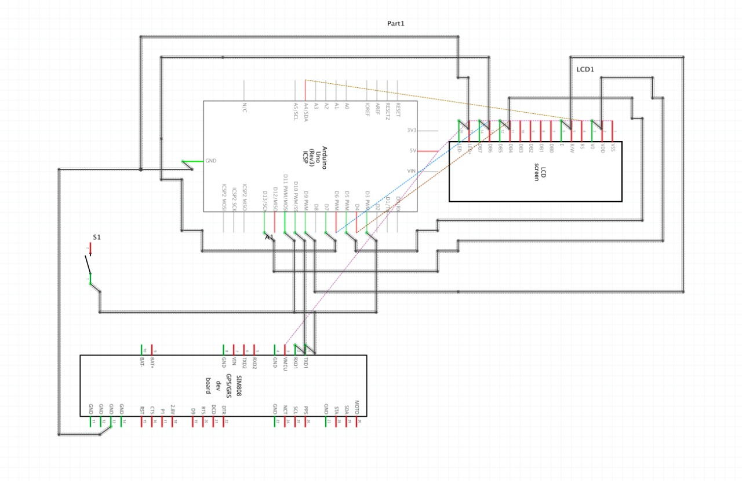
Schematic

Slide 9
Functional Requirements
Should be able to show information of buses for users in real time.
Must be able to estimate the accurate location of bus and display the location on map.
Show traffic delays on map and update arrival time.

Slide 10
Non Functional Requirements
To be able to estimate bus arrival time for users.
Reduce the work of bus management team in the Academy as it will be done automatically by the system as admins enter new information and estimate bus arrival time.
Users can access information anywhere in anytime.

Slide 11
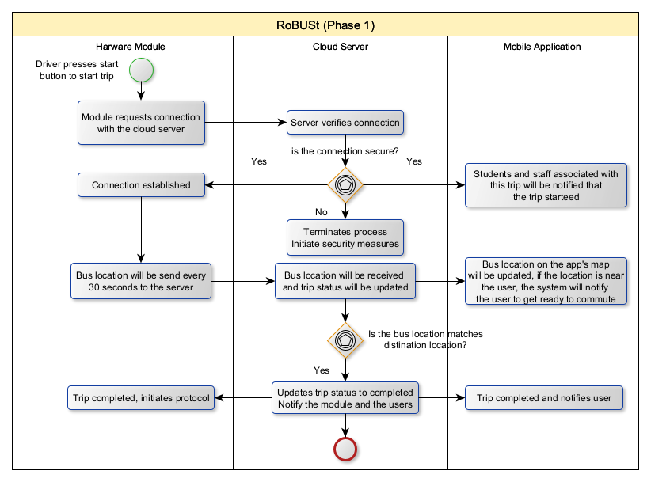
System Functionality

Slide 12
Next Step
Implement NFC reader to authenticate students of bus routes.
Implement the project in the AAST Bus System.
Implement MQTT IOT Protocol to establish a communication between client and server.

Slide 13
Resources
https://github.com/NaNo211/RoBust
https://www.researchgate.net/publication/334123684_GPS_and_GSM_Based_Vehicle_Tracking_System

